Slide 1

19F-0105 | Hassan Bin Tariq
19F-0143 | Tehreem Fatima
19F-0147 | Hareem Ai Malik

Slide 2
What are design patterns?
Reusable solutions to a general problem encountered in a particular context.
It should be kept as general as possible.
Should be proven beforehand.
Should be effective.
Studying patterns is an effective way to learn from the experience of others.

Slide 3
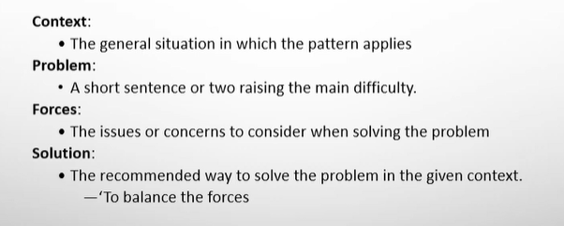
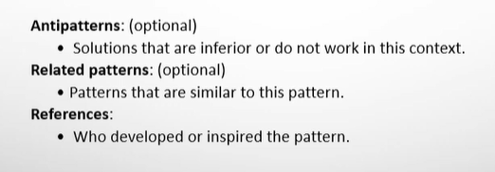

Slide 4
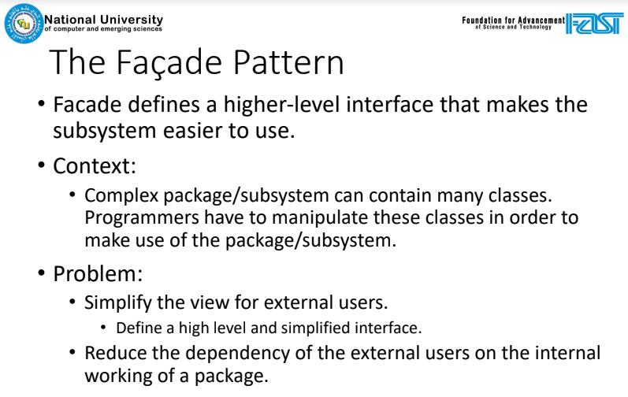

Slide 5
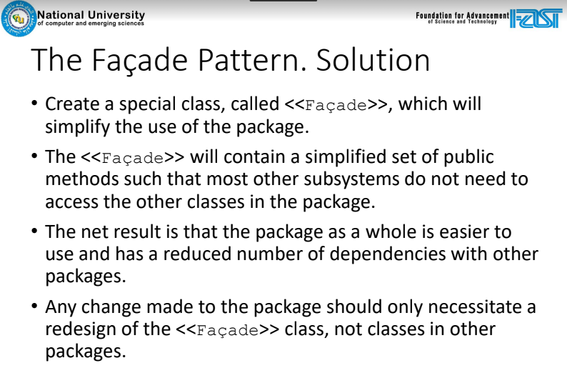

Slide 6
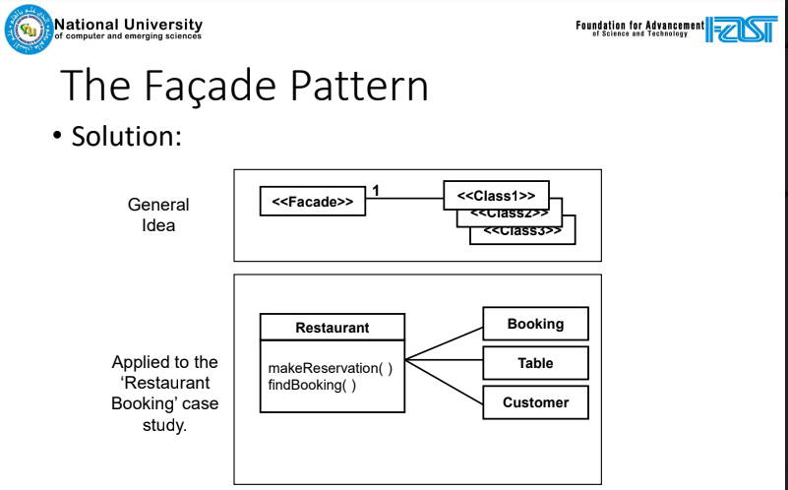

Slide 7
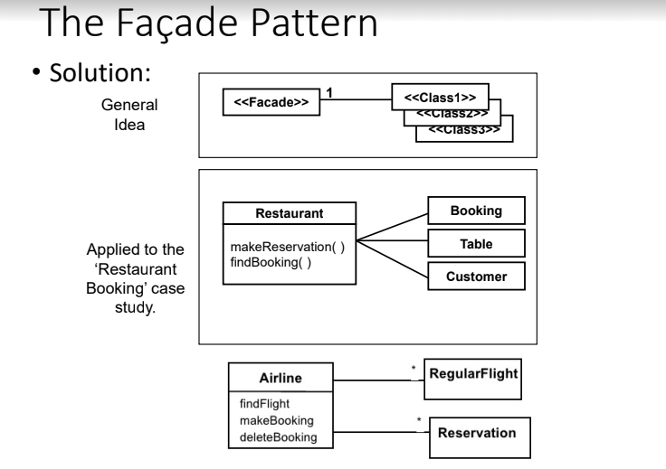

Slide 8
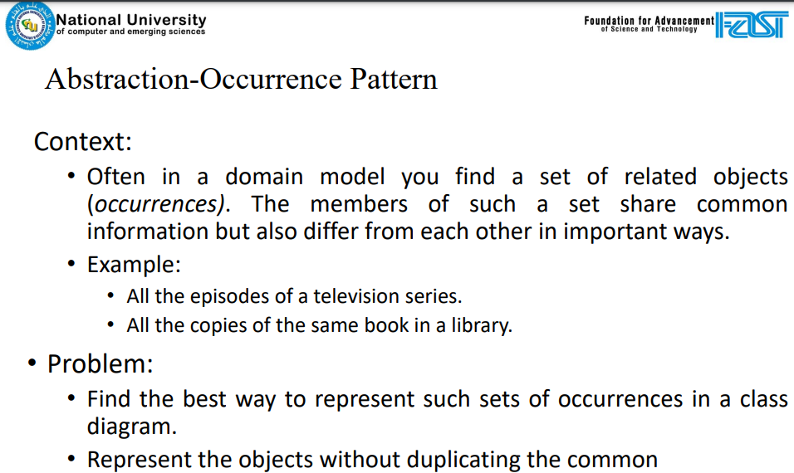

Slide 9
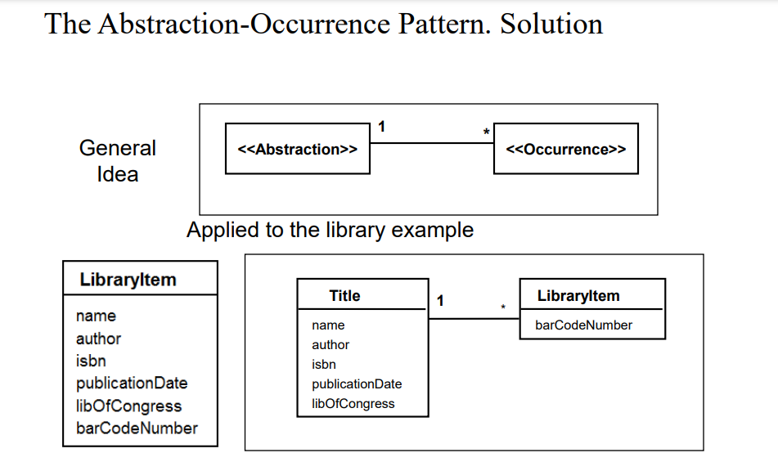

Slide 10
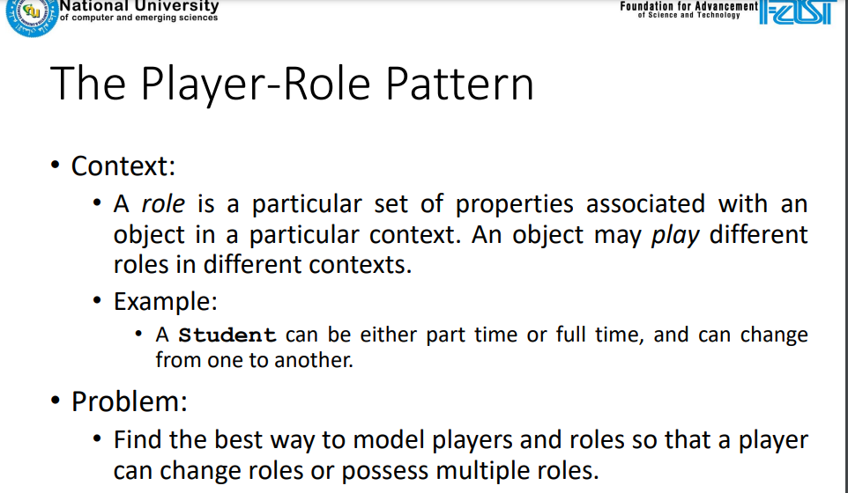

Slide 11
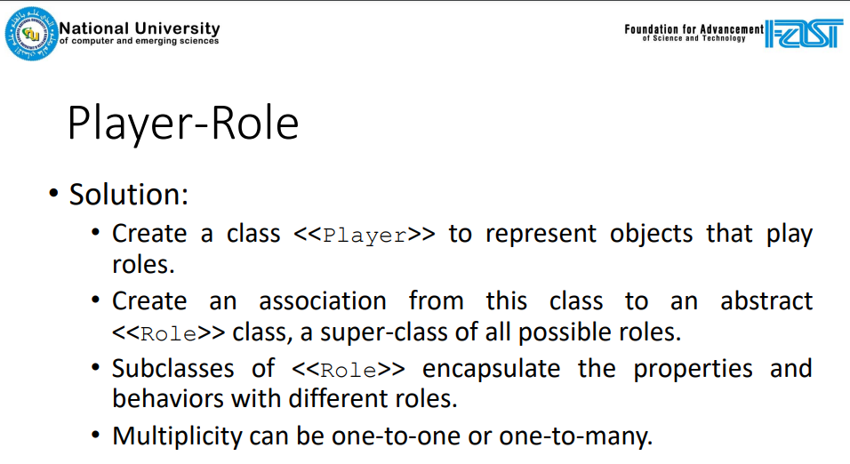

Slide 12
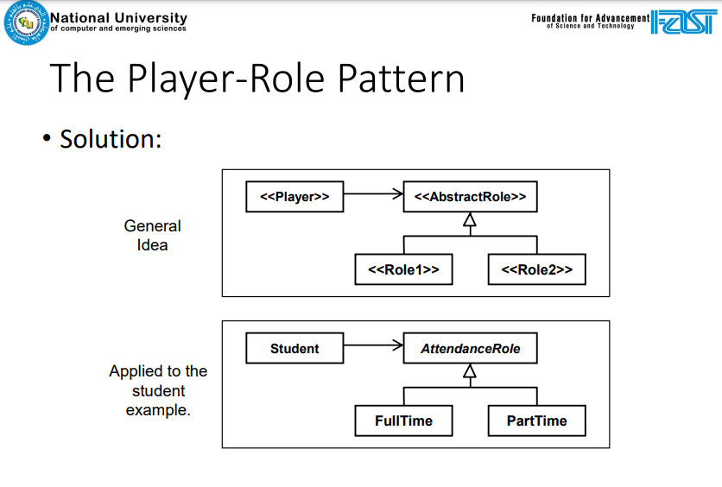

Slide 13
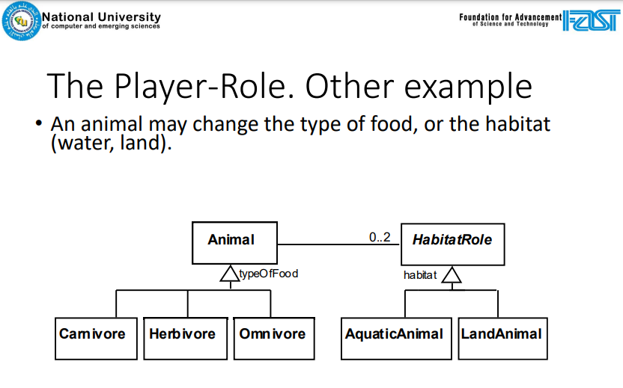

Slide 14
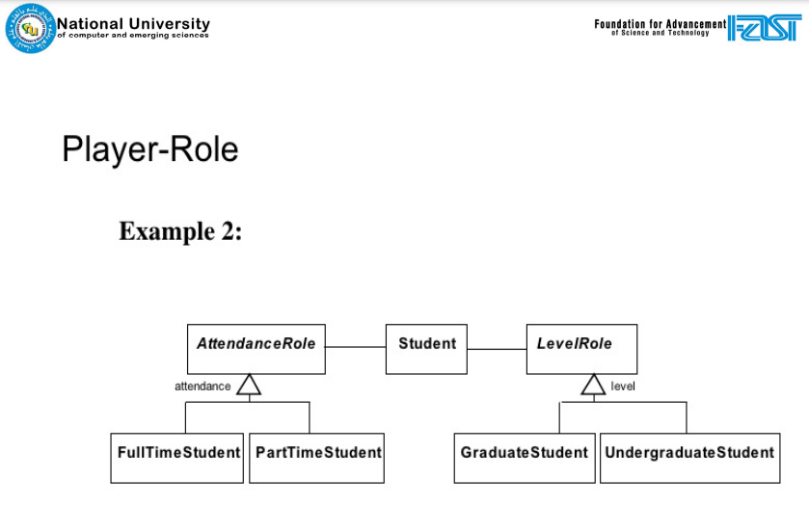

Slide 15


